Slide 1
Hands-on Bluetooth with CYW20719 and its peripheral Capabilities
Ranjith Kumar, Kishor Palleti, Pooja Gedupudi
1st February 2020

Slide 2
80% of the final exam will be based on one of the lecture you missed and the one book you didn’t read ☺

Slide 3
Agenda
Few Case Studies of Electronic Systems
Introduction to RF System-On-Chips (SoCs)
Overview of CYW920719Q40EVB-01 Evaluation board
Basics of Bluetooth and Bluetooth Low Energy
Basics of Wiced Studio IDE
CYW20719 Features
CYW20719 Peripherals
Device Architecture
System Resources and Peripherals
Low Power Modes
Writing your first Bluetooth application on CYW20719

Slide 4
Case Studies of Electronic Systems

Slide 5
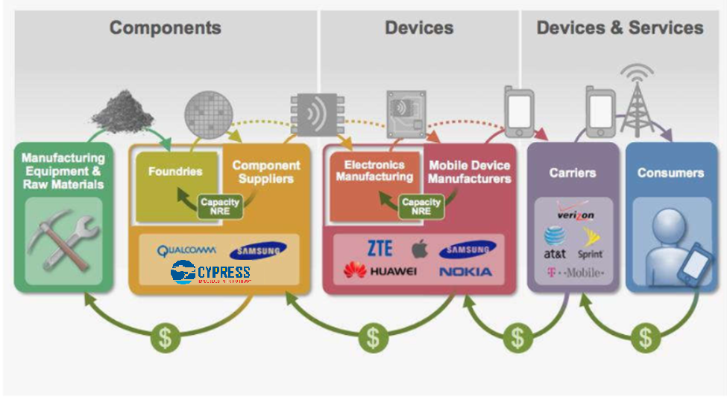
Simple Overview of Supply Chain in Electronics Industry

Slide 6
Players (Same Firm may play in different business units)
IC Fabs: TSMC, Samsung, UMC, Global Foundries, Cypress., etc.
IC Packaging: ASE Technology Holding, Amkor Technology, JCET, SPIL., etc.
Fab Machines: KLA Tencor, Applied Materials, ASML., etc.
IC Design: Cypress, AMD, Intel, Samsung, QCOM, TI, NXP, Infineon, Xilinx, Lattice, SignalChip., etc.
EDA: Cadence, Synopsys, Mentor Graphics, AutoCAD., etc.
Instrumentation/Mathematical Analysis: National Instruments(AWR Corporation), Mathworks, Ansys, Keysight, Agilent, Rohde & Schwarz, Teledyne Lecroy., etc.
Consumer Elec. : Fitbit, Garmin, Philips, Amazon(Lab 126), Western Digital., etc.
OEMs/ODMs: Apple, Samsung, Nokia, Huawei, Compal, Westron, Foxconn., etc.
Distributors/Module Vendors: AVNET, Arrow, Digi-key, mouser., etc.

Slide 7
Players (Continued…)
PCB Manufacturers/Services: Flextronics, Sanmina, OSHPark, design-spark, JLPCB, PowerPCB., etc.
Automotive: Bosch, Harman, Continental AG, Volvo, MB, Audi., etc.
Industrial/Robotics: Siemens, ABB, Schneider electric, General Electric., etc.
Aerospace/Defense: Boeing, Airbus, Bombardier, ISRO., etc.
RTOS/OS Development: Microsoft (ThreadX), Android (Linux Kernel), VxWorks, ENOS., etc.
NW/BB Provider: Alcatel, Cisco, Juniper, Huawei, AT&T, Nokia, ., etc.

Slide 8
Facts about Cypress Semiconductor
Started in Silicon Valley by Dr. T. J. Rodgers in 1982.
Best Known for
PSoC (Programmable System on Chip) Microcontrollers
Memory Technologies (SRAM, FRAM, MRAM, Flash Memories)
Sensing chips (Capsense, Magsense)
USB, Power Management ICs and wireless charging Products
Automotive Microcontrollers, clocks and buffers
IoT Products (Bluetooth, WiFi and Combo devices)
Cypress stands No.1 in USB-C markets, WiFi and Bluetooth Combo device markets, Auto Cluster MCUs, Touch and NOR Flash markets.

Slide 9
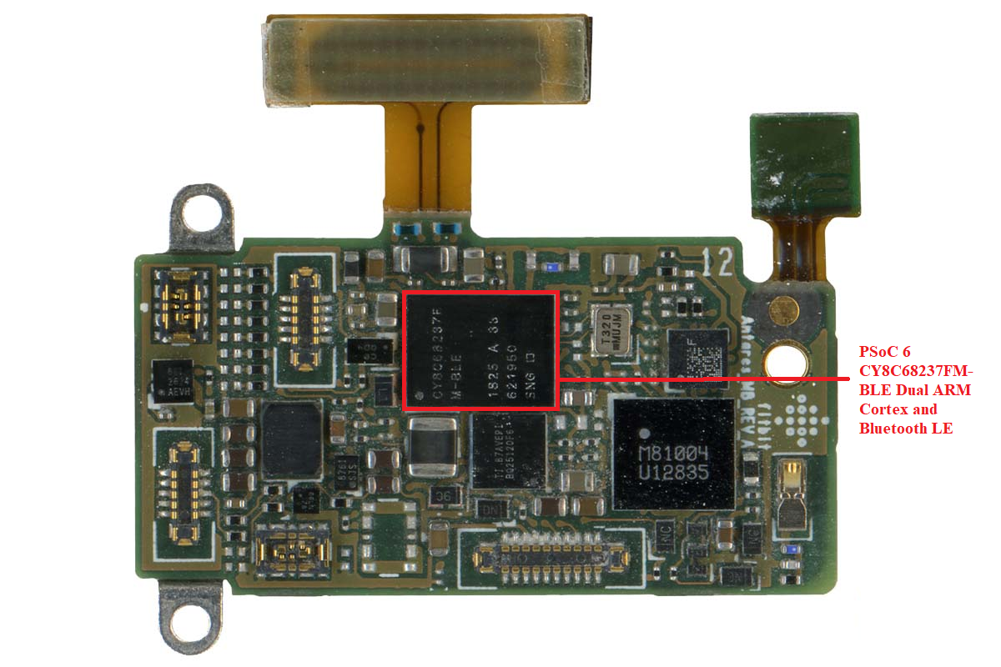
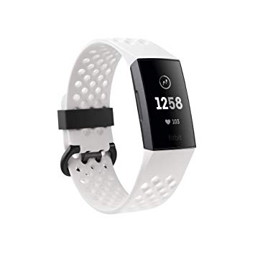
Smartwatch - Fitbit Charge 3

Slide 10
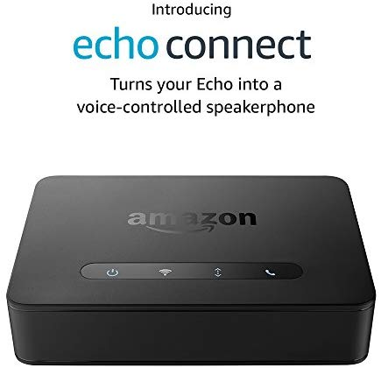
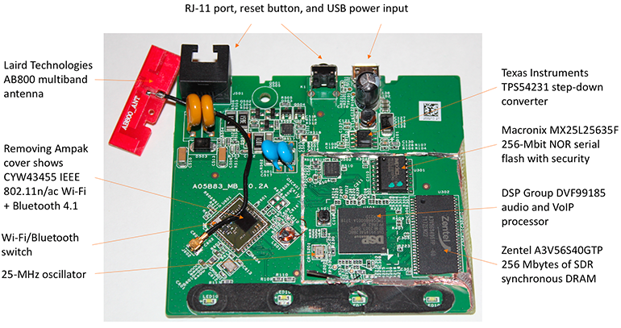
Amazon Echo Connect

Slide 11
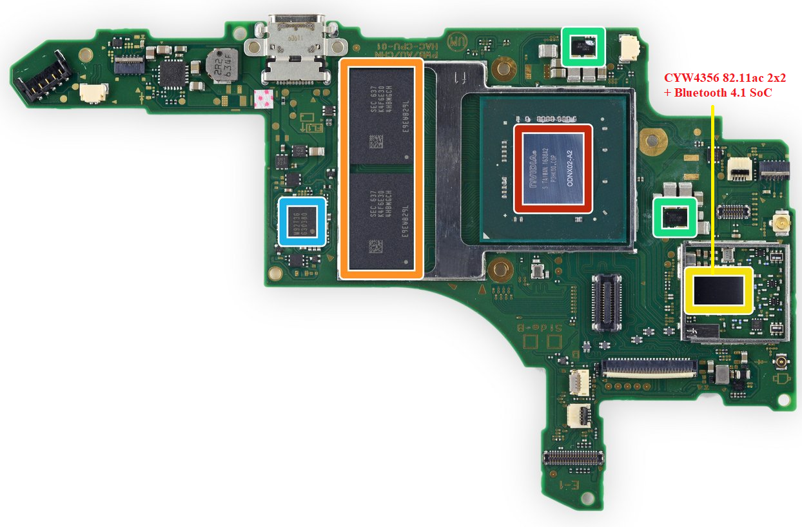

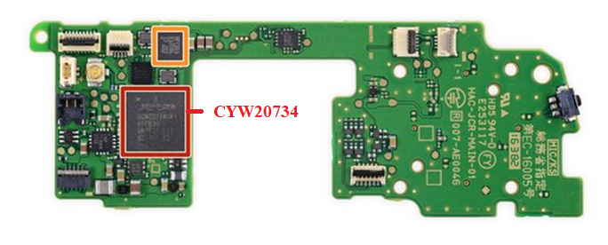
Nintendo Switch

Slide 12
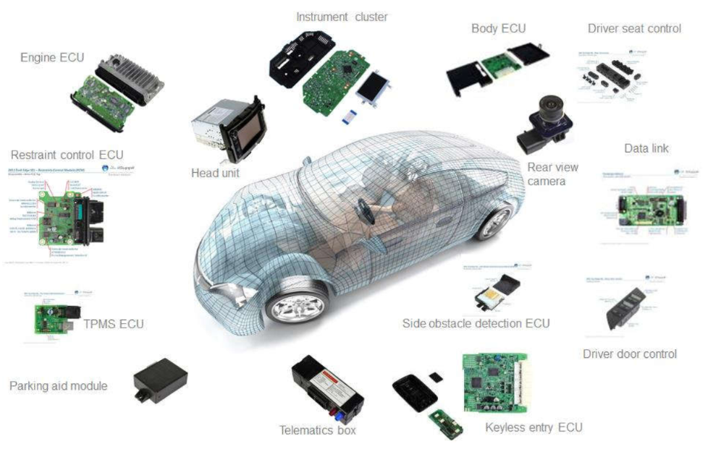
Automotive Systems

Slide 13
Quiz 1
What is Moore’s law?
Which are some of the common inter-chip bus communication interfaces?
Why do most Wireless protocols use 2.4 GHz band?
Notes:
ANS:
Moore's law is the observation that the number of transistors in a dense integrated circuit doubles about every two years.
I2C, SPI, CAN, LIN, SDIO, PCIe., etc.
ISM band

Slide 14
Introduction to RF System-On-Chips (SoCs)

Slide 15
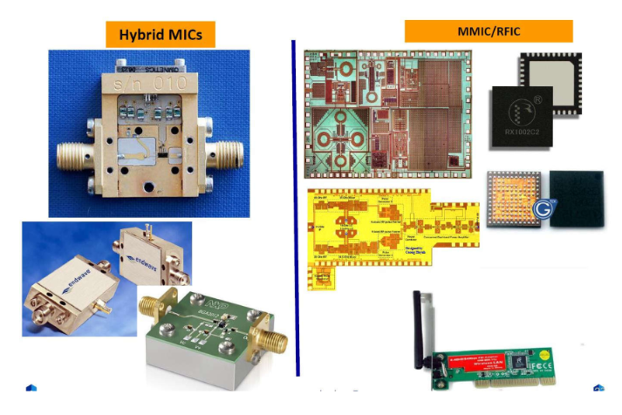
Fabrication Technologies of RF Circuits

Slide 16
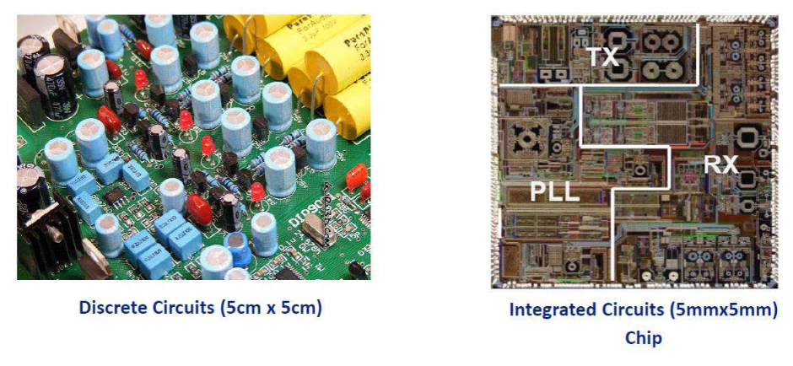
Discrete Components vs IC

Slide 17
Why do we need RF SoCs?
Replaces bulky and expensive waveguide and coaxial components with small and inexpensive planar components for smaller size, lighter weight, lower power requirements, lower cost, and increased complexity.
System-On-Chip solution as opposed to System-On-package Solution.
Reduces BOM cost and PCB footprint size.
More reliable circuits as opposed to 3rd party Front-end components
Tighter integration also means low power consumption
Relaxed Filter requirements
More processing on the digital domain compared to analog domain. This is advantageous for flexibility
RF SoCs further reduce the BOM cost

Slide 18
RF Basics
Radio Frequency waves are generated by the device(RF ICs) and sent over the antenna as EM waves.
RF signals : 300 KHz to 300 GHz ; Wave length: 1 Km –1mm
Microwave signals: 0.3 GHz –300 GHz ; Wave length: 1 m –10mm
Millimeter-wave signals: 30 GHz –300 GHz ; Wave length: 10 mm –1mm

Slide 19
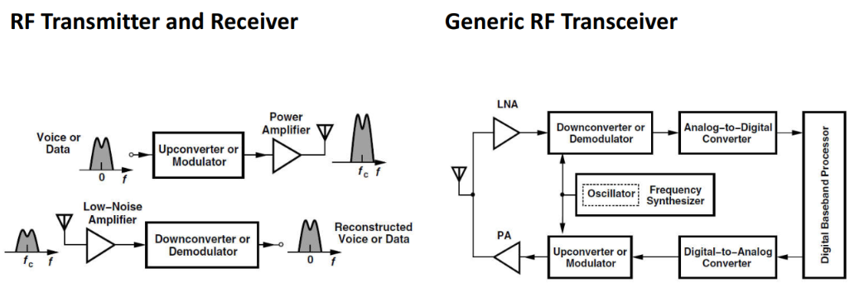
Overview of Wireless Communication System

Slide 20
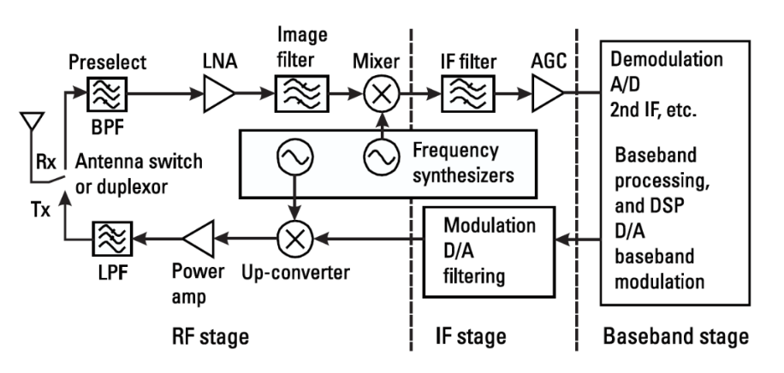
Typical RF Transceiver (More details)

Slide 21
Important Elements of a RF System
PAs – Transmitters - Drive antenna with high power level
LNAs – Receivers - Sense small signal (amplify with low noise)
Mixers – Mixers perform frequency translation by multiplying two waveforms. Multipliers in the Time domain & Convoluters in the frequency domain.
VCOs - An RF oscillator must be designed such that its frequency can be varied(tuned) across a certain range.
Frequency Synthesizers - Helps VCOs correct the frequency output errors.

Slide 22
Few Important RF Units & Parameters
RF design has traditionally employed certain units to express gains and signal levels.
dB vs dBm
Voltage gains and Power gains are expressed in dB.
The absolute signal levels are often expressed in dBm rather than in watts or volts. Used for power quantities, the unit dBm refers to “dB’s above 1mW.”
S parameters – Scattering Parameters
Smith’s chart characteristics

Slide 23
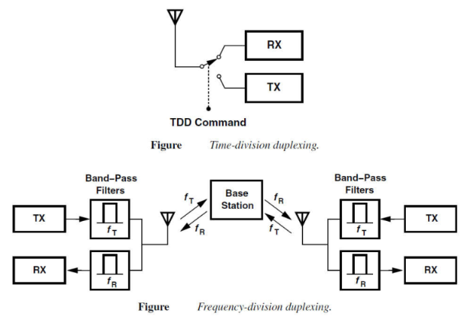
Duplexing / Multiplexing
The simplest case of multiple access is the problem of two way communication by a transceiver, a function called “duplexing.”
Multiplexing is the process of simultaneously transmitting two or more individual signals over a single communication channel eg: cable or wireless.

Slide 24
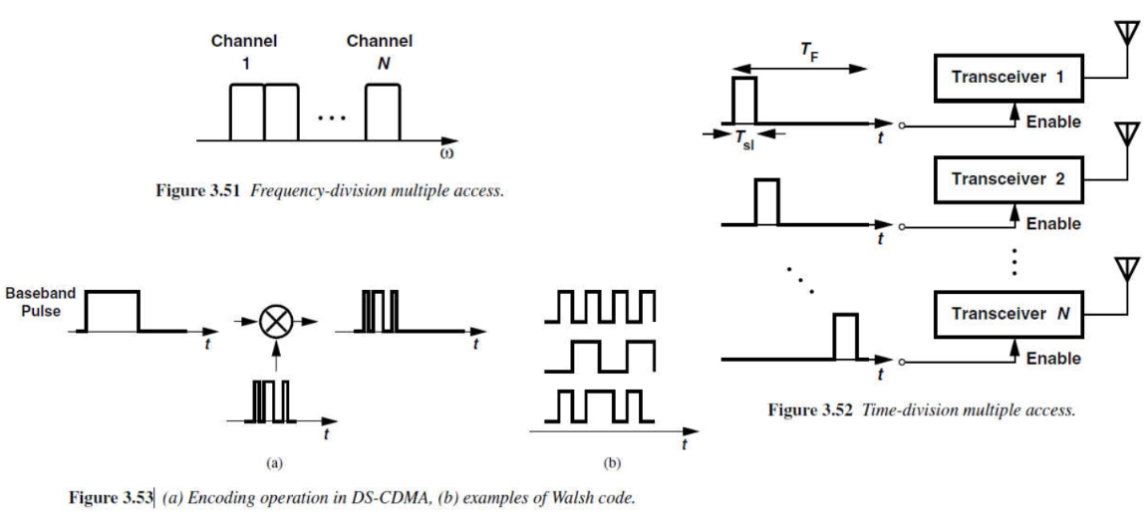
Multiple Access Techniques

Slide 25
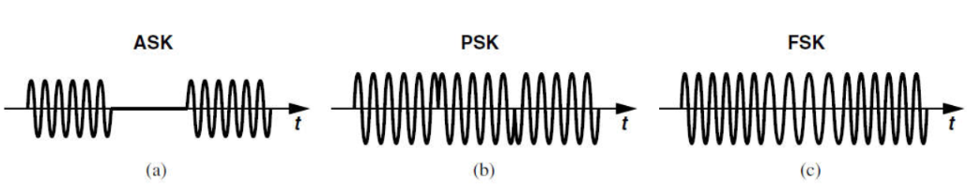
Modulation
Modulation refers to a process of turning information into (electrical) signals which are suitable for transmission.
Carrying the information in digital form offers many advantages over communication in the analog domain.
The digital counterparts of AM, PM, and FM are called “amplitude shift keying” (ASK), “phase shift keying” (PSK), and “frequency shift keying” (FSK), respectively .

Slide 26
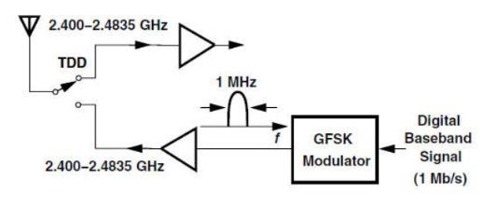
Example – Bluetooth classic Air Interface

Slide 27
Protocol Stacks and application Firmware
All the baseband hardware and the MCUness of the SoC are controlled by the registers defined in the RTL.
Most of the bare-metal code for controlling the registers are written in assembly (depends on the core) and C. Memorizing assembly is not that necessary (This suggestion is not for academics).
Most of the protocol stacks are written in a way like a Finite State Machine(FSM) to aid event-driven programming and are mostly time-sensitive.
Firmware is a generic term and can represent any part of the code (code memory) that lies in any part of the memory such as ROM, Flash (internal and external).

Slide 28
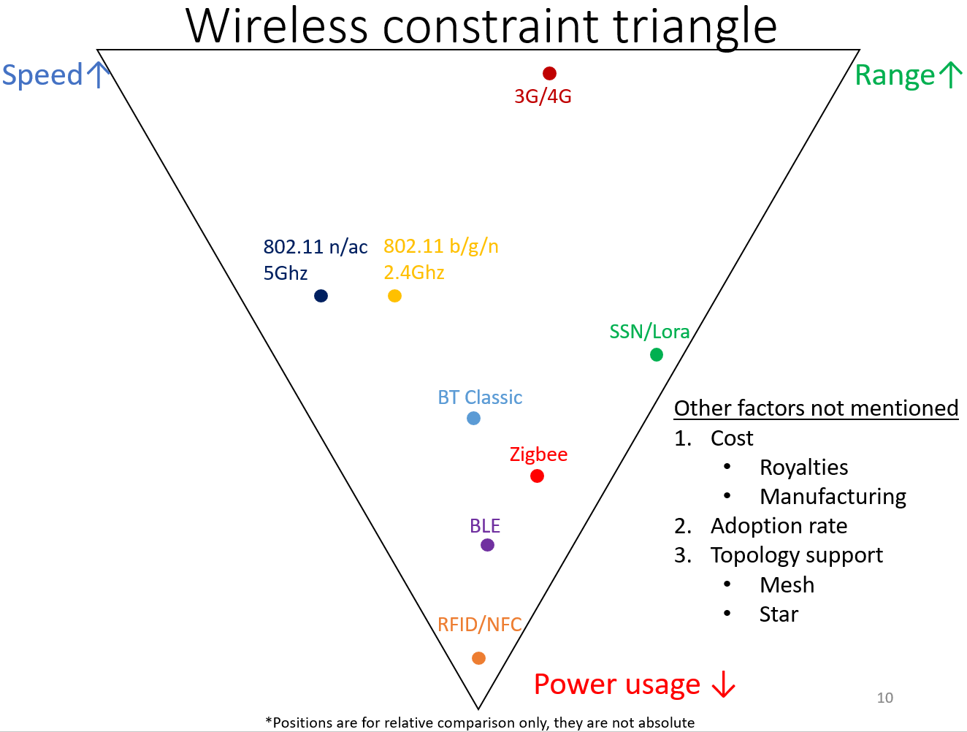
Some of the Wireless Protocols & their Standard Organizations
3GPP - 2G GSM/3G WCDMA/4G LTE(VoLTE) /5G
IEEE & WiFI Alliance - WiFi – a/b/g/n/ac/ax/p
Bluetooth SIG - Bluetooth- 2…5.x
Google - Threadx
ZigBee
WiGig
GPS/GLONASS/GNSS/Beidou/IRNSS
NFC

Slide 29
CYW20719 Development Kits

Slide 30
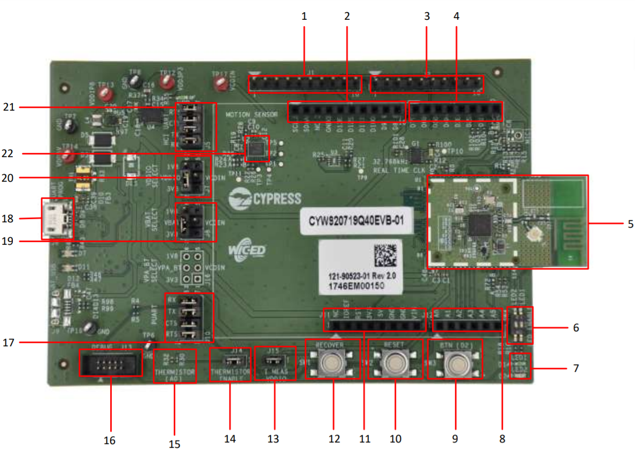
CYW920719Q40EVB-01 Evaluation board - Top

Slide 31
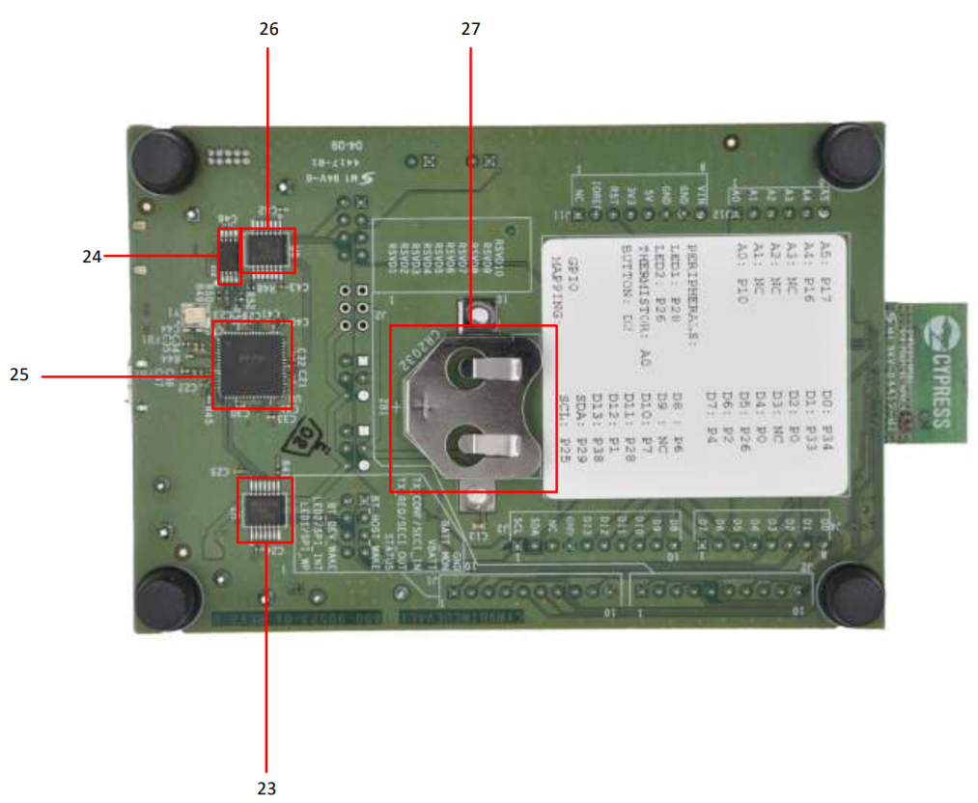
CYW920719Q40EVB-01 Evaluation board - Bottom

Slide 32
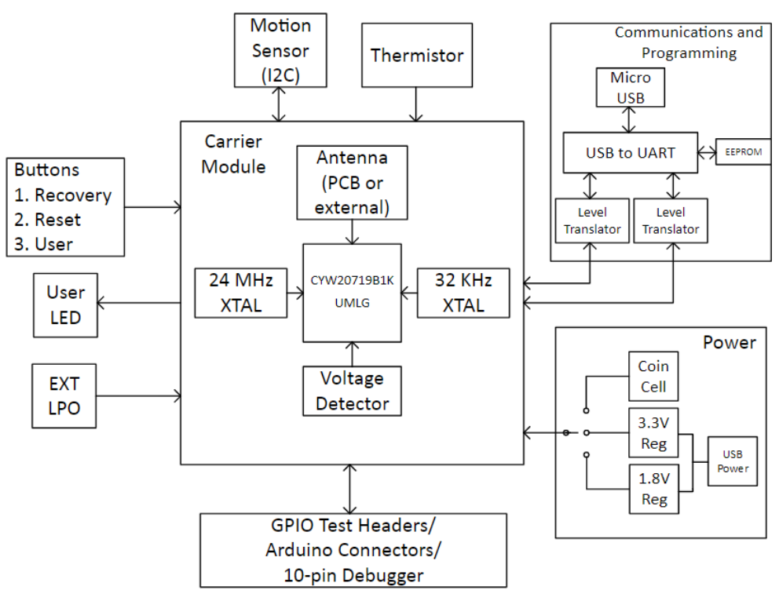
Overview

Slide 33
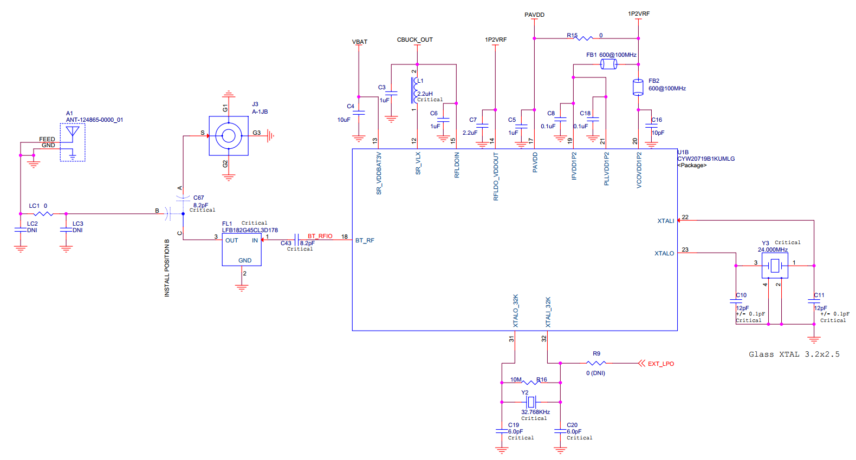
Schematics of CYW20719 based RF FE on PCB

Slide 34
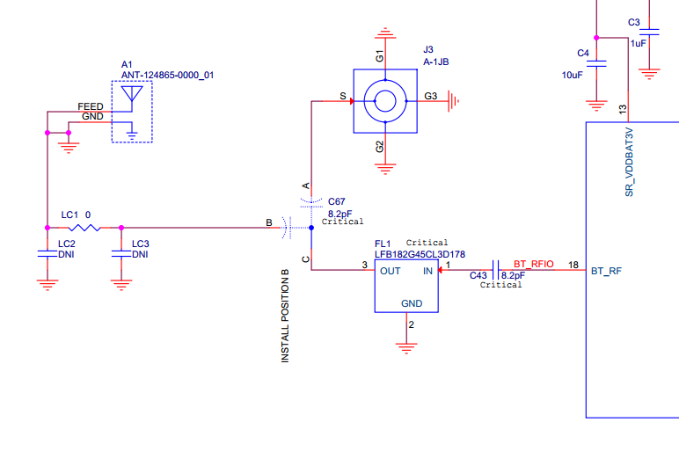
Zoomed in Version

Slide 35
Quiz 2
What are the difficulties of designing High frequency RF Circuits on a PCB?
Why do we require Power Management ICs?
List out the different types of Antennas used?
Notes:
ANS:
Impedance Matching, Noise from other HF circuits as it behaves as Antennas
Different power rails are required. The power design of the device has multiple requirements for operation.
Loop antenna, Planar F-antenna, ceramic chip antenna(on a PCB)
Wire Antennas
Short Dipole Antenna
Dipole Antenna
Loop Antenna
Monopole Antenna
Log Periodic Antennas
Bow Tie Antennas
Log-Periodic Antennas
Log-Periodic Dipole Array
Aperture Antennas
Slot Antenna
Horn Antenna
Microstrip Antennas
Rectangular Microstrip Patch Antenna
Quarter-Wave Patch Antenna
Reflector Antennas
Flat-plate Reflector Antenna
Corner Reflector Antenna
Parabolic Reflector Antenna
Lens Antennas
Travelling-wave Antennas
Long Wire Antenna
Yagi–Uda Antenna
Helical Wire Antenna
Spiral Antenna
Array Antennas
Two-Element Array Antenna
Linear Array Antenna
Phased Array Antennas

Slide 36
Bluetooth Low Energy and its History
Bluetooth was formalized by BT SIG - 20th May 1998
Bluetooth Low Energy v4.0 – 30th June 2010
Bluetooth Low Energy v5.2 – with LE Audio - 7th January 2020
As an alternative to the Bluetooth standard protocols that were introduced in Bluetooth v1.0 to v3.0, BLE is aimed at very low power applications powered by a coin cell.
For comparison, Typically BLE consumed 0.01 – 0.5 W compared to Classic Bluetooth’s 1W of power.
Standards prior to v4.0 is referred as Classic Bluetooth.

Slide 37
Bluetooth Low Energy (BLE 4.0 & above)
Uses 2.4 GHz ISM Band
Industrial Scientific Medical band
License Free – with certain rules
2400 MHz to 2483.5 MHz
RF Channels f=2402 + k * 2 MHz , k=0,…,39

Slide 38
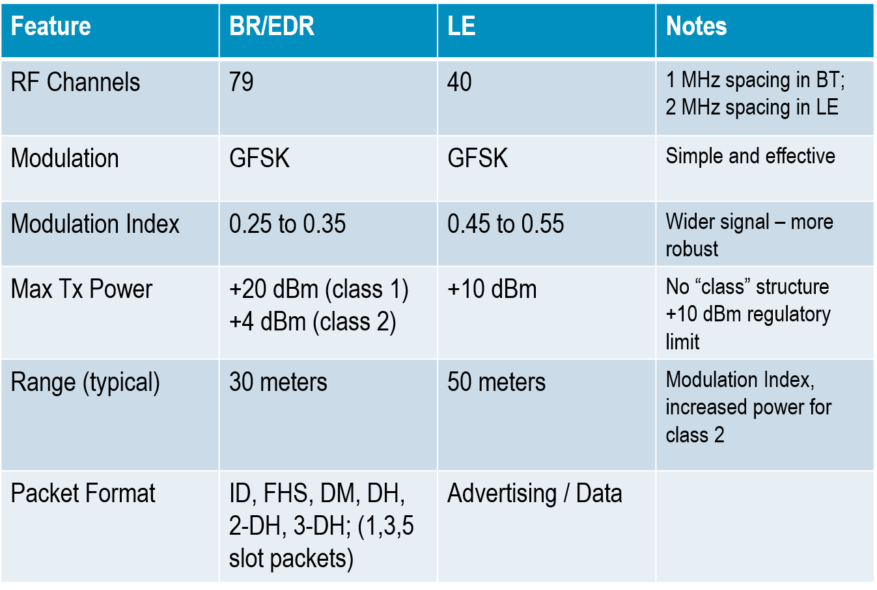
Why BLE?
Support of Low energy connectivity applications.
Expected to operate without a battery change for an extended period of time.
Support for very low data rates.

Slide 39
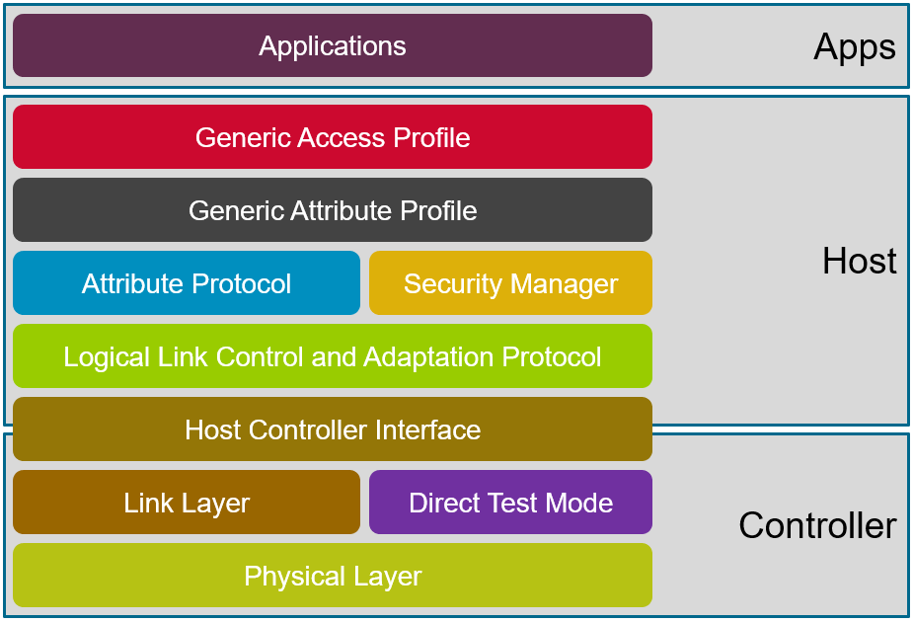
BLE Stack Architecture

Slide 40
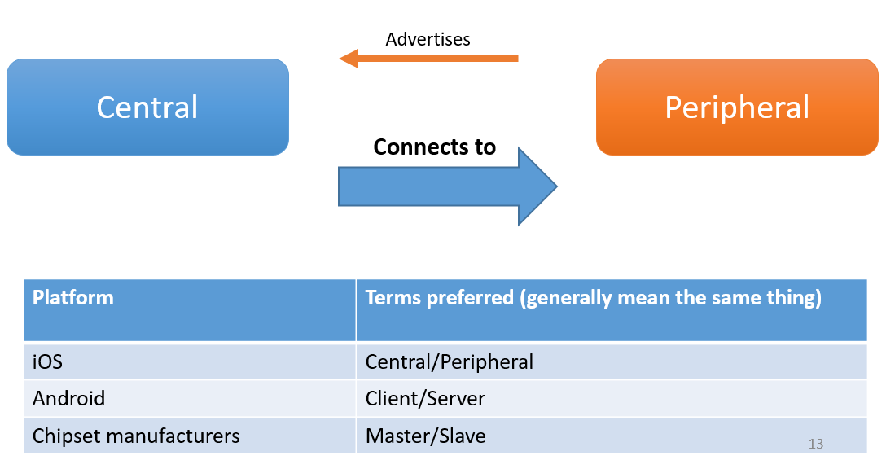
Device Roles (Different terminologies)
Central can connect to many peripherals at the same time
Peripheral can connect to only one central at any one time.

Slide 41
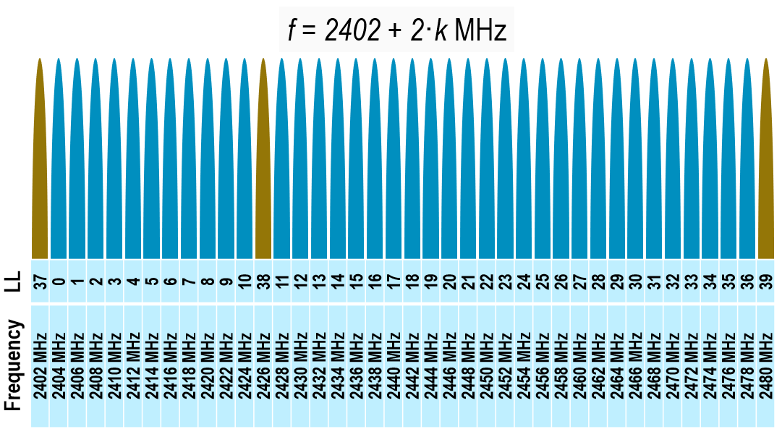
BLE Advertising and Data Channels – Physical Layer

Slide 42
Discovery and Connection – Link Layer
Defines how two BLE devices communicate.
Defines Advertising, Scanning, Connecting, Packet Format
BLE protocol defines Advertiser and Scanner activities for discovering peers and getting into a BLE connection. For ex:
A sensor application will typically Advertise when in the ON state and not in a connection. The sensor device will take a slave role once in a connection.
The other side will typically Scan for Advertisers when in the ON state and not in a connection. This device will take the master role once in a connection.
Link Layer states are summarized in the specification as follows:
Standby State
Advertising State
Scanning State
Initiating State
Connection State

Slide 43
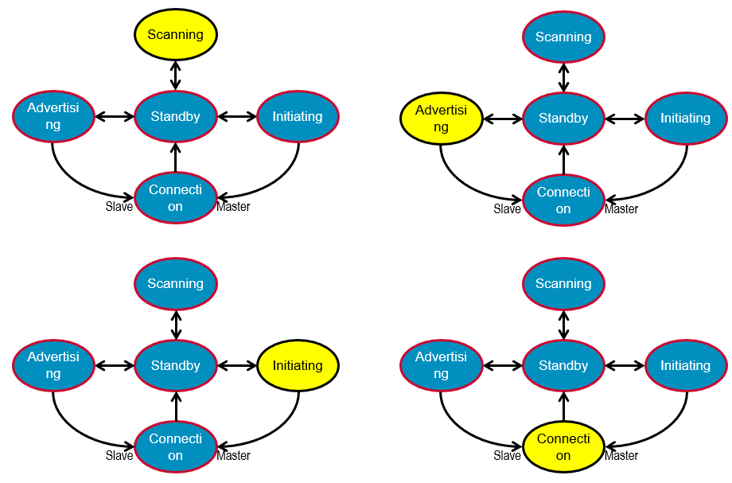
Link Layer State Machine

Slide 44
L2CAP
Segmentation and reassembly of packets
4-byte header
MTU (Maximum Transmission Unit)
BLE 4.0 & 4.1 - 23 bytes
BLE 4.2 & above – 247 bytes
Protocol multiplexing
0x0004: ATT Channel (usually used)
0x0005: LE signalling
0x0006: Security Manager

Slide 45
Attribute (ATT) Protocol
Action to be taken (Read/Write/…) – Basically a command
1-byte instruction opcode
2-byte handle (ID of relevant service/characteristic/descriptor)
Bluetooth 4.0 & 4.1
MTU(Maximum Transmission Unit) size - 20-byte
Bluetooth 4.2 & above – Link Layer changes for DLE allows for more throughput
MTU(Maximum Transmission Unit) size - 244-byte

Slide 46
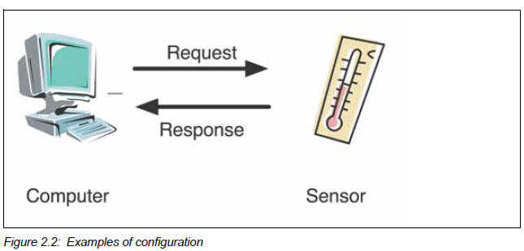
Generic Attribute (GATT) Profile
Service framework which uses the Attribute protocol
Defines procedures and formats of services and their characteristics. What is it for?
It specifies how the data is stored and exchanged once connected.
Identifies Services, Characteristics and Descriptors
Profile dependency
Server – Has the data
accepts incoming commands and requests from the client
sends responses, indications and notifications to a client
Client – wants the data
initiates commands and requests towards the server
receive responses, indications and notifications sent by the server

Slide 47
Service, characteristic, descriptor
GATT
Service1
Service2
Characteristic1
Properties: Read, Notify
Characteristic1
Properties: Read, Write
Descriptor1
Characteristic2
Properties: WriteWithoutResponse
Descriptor1
Descriptor2
Notes:
GATT elements such as Services, characteristics and descriptors are contained by Attributes
GATT composed of 1 or more services necessary to fulfill a use case

Slide 48
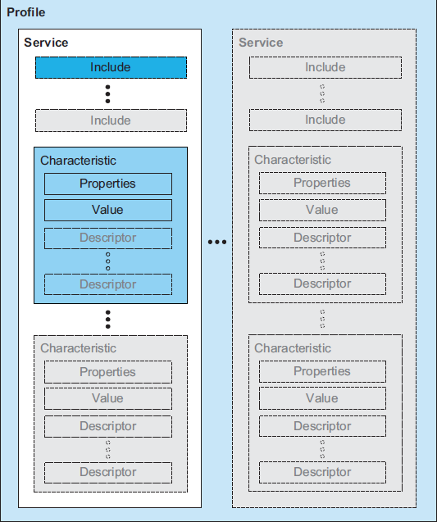
Service, Characteristic and Descriptor
Service - collection of data and associated behaviors to accomplish a particular function or feature
16-bit SIG services: Battery, Heart rate, Immediate Alert, Tx Power
128-bit UUID for custom services
Collection of characteristics
Primary Service
exposes the primary usable functionality of this device
discovered using Primary Service Discovery procedures
Secondary Service
service that is only intended to be referenced from a primary or another secondary service or other higher layer specification

Slide 49
Service, Characteristic and Descriptor(continued)
Characteristic
Holds a value: String, Int, Char…..
Can take on multiple properties:
Read: Central can read this value directly
Write: Central can write/change this value and be notified if executed successfully
WriteWithoutResponse: Central just “fire and forget”
Notify: Central gets alerted if the value has changed
Others: Broadcast, Indicate, SignedWrite, QueuedWrite, WritableAuxiliaries
Collection of optional descriptors
Descriptor: usually optional
Holds a value
Used to describe a characteristic (meta-data)
Special case: Client Characteristic Configuration Descriptor (0x2902)
Usually automatically created for characteristics with “notify” property

Slide 50
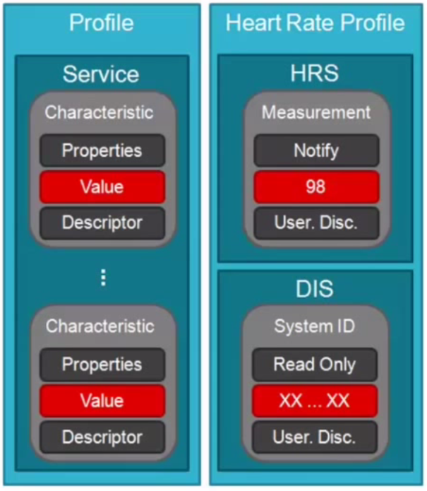
Profiles and Services
A Profile defines and describes the use of services necessary to implement a given Application.
Bluetooth SIG adopted examples:
Heart rate Profile
Heart Rate Service (HRS)
Device Information Service (DIS)
Proximity Profile
Link Loss Service
Immediate Alert Service
Find Me Profile
Immediate Alert Service

Slide 51
Generic Access Profile (GAP)
Information advertised to central before connection
Name of peripheral
Is it connectable?
Supported features (services)

Slide 52
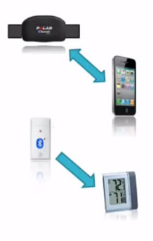
BLE GAP Device Roles
Broadcaster
An advertiser that is non-connectable.
Ex: Temperature Sensor
Observer
Scans for advertisements, but cannot initiate connections
Ex: Temperature Display
Peripheral
An advertiser that is connectable
Operates as a Slave after connection
Ex: Heart rate sensor
Central
Scans for Advertisements and initiates connections
Operates as a master in connections.
Ex: Smartphone

Slide 53
BLE connection procedure
Central
Broadcaster
Observer
Peripheral
1. Scanning
Broadcasts advertisement packets (GAP)
Advertising
2. Received advertisement packet (Stop here for beacon devices)
2.5. Connection attempt
Connected success, stops advertising
Connect success
3. Connect success,
now lets find out more
Discover services
Send back services info
Services data (GATT)
4. Services discovered, lets dig deeper
Discover characteristics
Send back characteristics info
Characteristics data (GATT)
5. Discovery completed, ready to use peripheral
Discover descriptors (usually optional)

Slide 54
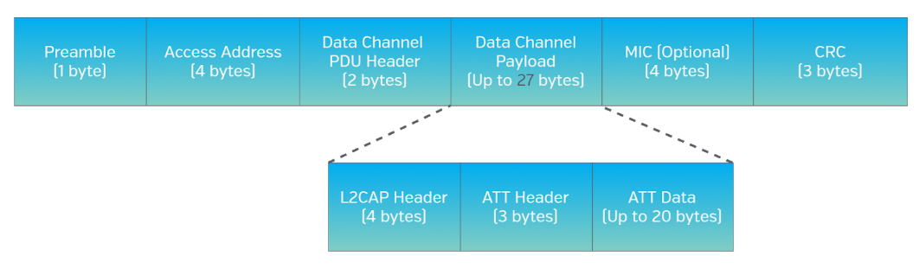
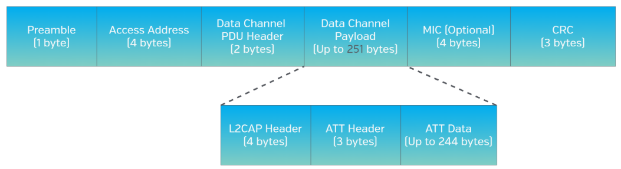
Link Layer Packet Structure - Protocol Data Units (PDUs)
2 Types:
Advertisement Channel PDUs
Data Channel PDUs
Bluetooth SIG introduced Data Length Extensions in v4.2 Specifications.
Increased throughput

Slide 55
HCI – Host Controller Interface
Host gives commands to the controller over HCI
Can be a single-chip or dual chip solution.
To enable interoperability between host and controllers produced by different manufacturers.
Usually HCI UART or USB.

Slide 56
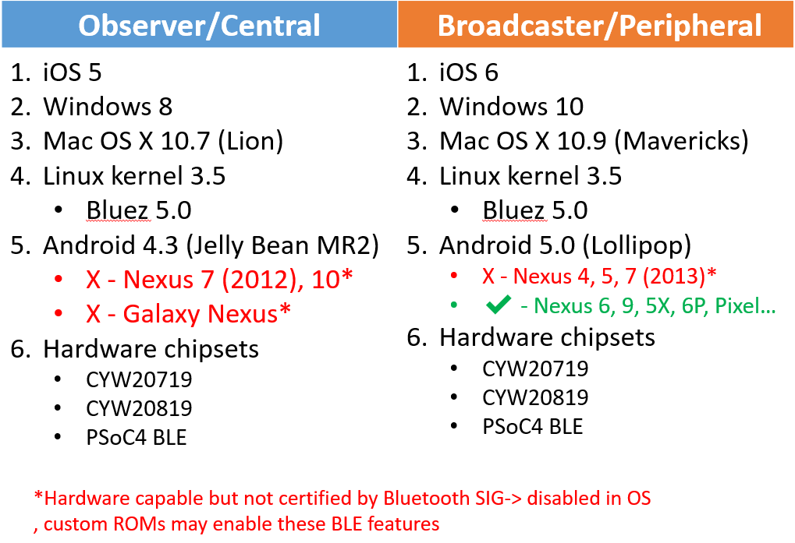
OS / Device Compatibility

Slide 57
Quiz 3
Where did the term “Bluetooth” come from?
Which are some of the most used profiles in Classic Bluetooth?
How can I design a BLE solution to reduce the interference with WiFi?
Notes:
ANS:
Danish King Harold Bluetooth
A2DP, HFP, HID, SPP, AVRCP
Co-Existence Interface

Slide 58
CYW20719 Support in Wiced Studio IDE

Slide 59
Wiced Studio IDE
Wiced Studio™ software is a set of tools that enable you to integrate Cypress devices into your existing development methodology
Wiced Studio is an IDE based on Eclipse IDE that supports Cypress Wireless connectivity devices with the help Bluetooth SDK and WiFi SDK.
For the workshop, We’ will concentrate mostly on the BLE peripheral side.
For further learning on Classic Bluetooth, BLE Mesh and OTA, please refer to the Cypress Semiconductor Github repository on the theory and implementation of applications.

Slide 60
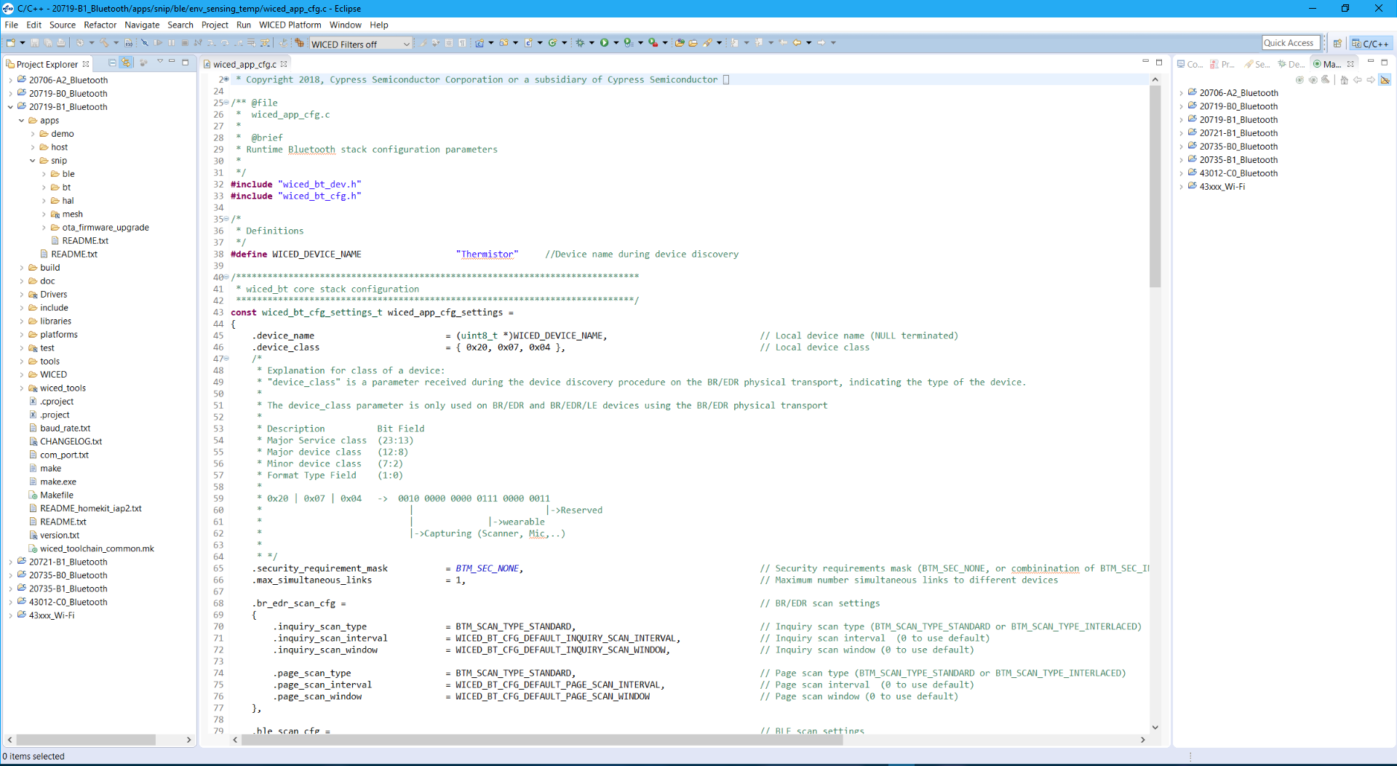
A Glimpse of Wiced Studio

Slide 61
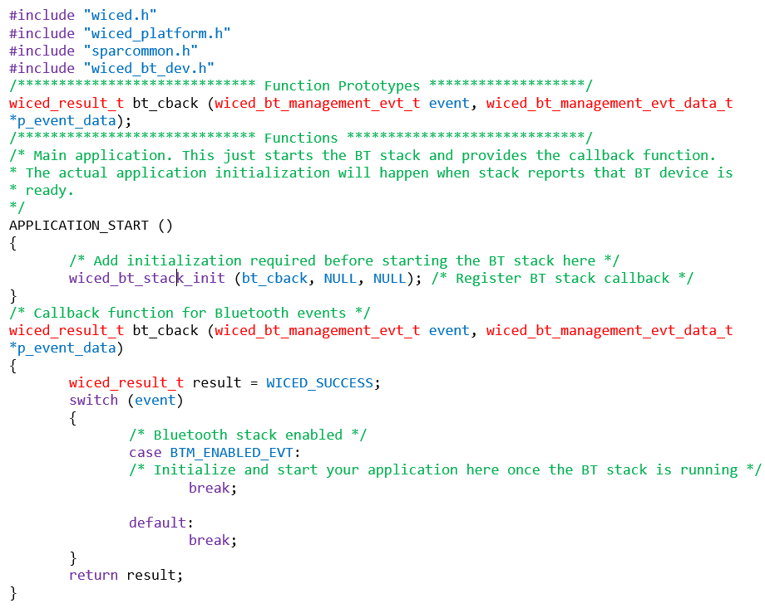
Minimal Application – Hello World of Wiced Environment

Slide 62
CYW20719 Device Architecture

Slide 63
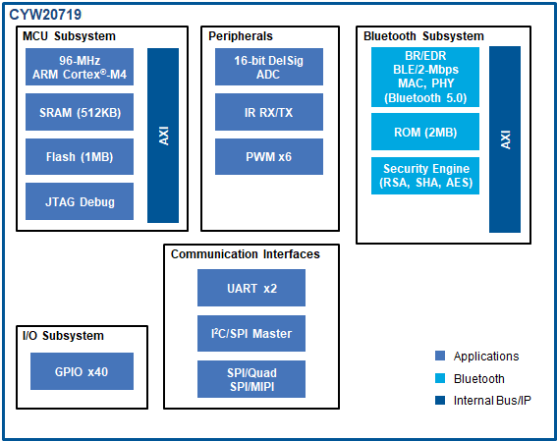
CYW20719 Block Diagram
Bluetooth v5.0, Basic Rate + Enhanced Data Rate + Bluetooth Low Energy and BLE Mesh
Industry’s most widely deployed Bluetooth stack
2-Mbps LE support
2 MB ROM for Bluetooth stack, Mesh, Threadx and other key libraries to let most applications fit in small flash footprint
Ultra low power BLE
BLE - 14 uA Tx @ 0 dBm and 122 uA Rx
High transmit power to achieve long range
CYW20719 - 4 dBm Tx BLE mode and 0 dBm Tx in EDR
MCU Subsystem
96-MHz Cortex®-M4
512KB SRAM, 1MB Flash
Packages
40-QFN 5x5 mm and 134-ball WLCSP 3.2x3.2 mm

Slide 64
System Resources – Power Domains
Two power domains exist
VBAT is used to power the core
VDDIO is used to power the peripherals and GPIOs
Voltage range for both VBAT and VDDIO : 1.8-3.3V
This allows peripherals to work at a different voltage than the core and allows power saving

Slide 65
System Resources - Clocks
High Frequency (HF) clock derived from external 24 MHz crystal
PLL converts clock to 96 MHz
96 MHz clock divided to various frequencies for different blocks
ACLK0 and ACLK1 can be derived from 24-MHz HF clock or 1-MHz HF clock
SPIs, UARTs, I2C clock derived from PTU clock which in turn derived from HF clock
Low Frequency (LF, marked as lhl_lpo32k) clock derived from external 32 Khz crystal or internal LPOs
RTC sourced from LF clock
PTU – Peripheral Transport Unit ACLK – Auxiliary clock
HP-LPO – High Power LPO LP-LPO – Low Power LPO

Slide 66
System Resources - GPIOs
Two types of GPIOs
LHL GPIOs are general purpose GPIOs to route most of the peripherals
Arm GPIOs are GPIOs for specialized functions like DEV_WAKE, HOST_WAKE
CYW20719 supports the following GPIO capabilities:
Input / Output selection
Pull-up / Pull-down selection
Drive strength selection
Hysteresis control
Level / Edge triggered interrupt selection
Certain functionalities (for example ADC input) are supported only on specific LHL I/Os
GPIOs such as P26, P27, P28, and P29 supports higher current source/sink compared to other pins.
Package | LHL GPIOs | Arm GPIOs
CYW20719B1KWB9G (134-ball WLCSP) | 40 | 6
CYW20719B1KUMLG (40-pin QFN) | 22 | 2
Notes:
*source/sink 8 mA at 3.3V and 4 mA at 1.8V
*P26/P27/P28/P29 sink/source 16 mA at 3.3V and 8 mA at 1.8V

Slide 67
System Resources - GPIO SuperMux
Flexible mux functionality for LHL GPIOs
Most peripherals can be routed to any LHL GPIOs using supermux
Device configurator can be used to easily route peripheral signals to GPIOs
List of peripheral signals that can be “supermuxed” can be found in datasheet

Slide 68
Peripherals - ADC
Single-ended switched-capacitor sigma-delta ADC with ENOB of 10 bits for general purpose measurements, and 12 bits for Audio* applications
ADC Inputs: (Cannot be supermuxed)
The following 15 pins can be programmed as ADC inputs in CYW20719B1KUMLG (40-pin QFN):
P0, P1, P10-P11, P13, P16-17, P23, P28, P29, P33-P36, P38
The following 28 pins can be programmed as ADC inputs in CYW20719B1KWB9G (134-ball WLCSP):
P0, P1, P8-P19, P21-P23, P28-P38
Voltages of VDDIO, VDD_CORE, ADC_BGREF, and ADC_REFGND can also be measured using ADC
APIs are available in : wiced_hal_adc.h
The wiced_hal_adc_init() function initializes the necessary registers required for ADC operation in DC measurement mode. The ADC needs to be re-initialized if it has been powered down in specific low-power modes
The wiced_hal_adc_read_voltage() API function allows the program to read the analog voltage from the ADC
* Audio mode is available only in CYW20819A1KFB1G package

Slide 69
Peripherals - Pulse-Width Modulation
Six 16-bit Hardware PWM are available
Supports 2 clock sources:
LHL Clock at 32 KHz
ACLK1 at 24 MHz
Supports SuperMux Functionality
APIs are available in : wiced_hal_pwm.h
The wiced_hal_pwm_start() function configures, enables, and starts the PWM and also routes it to a preconfigured GPIO pin. This function takes in five parameters (i.e., channel, clock source, toggle count, initial count, and invert signal)
The channel refers to PWM channels 0 to 5
The clock source can be either LHL_CLK or ACLK1 (PMU_CLK)
The toggle count refers to the number of ticks to wait before toggling the signal
The initial count is the initial value of the register
The invert signal can be either 1 or 0. If the invert signal is 1, the PWM output starts at logic HIGH and if the invert signal is 0, the PWM output starts at logic LOW

Slide 70
Peripherals – Real Time Clock (RTC)
Supports a 48-bit RTC Timer running on 32 KHz Low Power Oscillator
Supports clock input from either an external or internal LPO
By default, the date and time are set to January 1, 2010 with a time of 00:00:00 denoting HH:MM:SS
APIs are available in : wiced_rtc.h
wiced_set_rtc_time() – To set the current time of wiced_rtc_time_t structure
wiced_rtc_get_time() – To get the current time of wiced_rtc_time_t structure
wiced_rtc_ctime() – To convert the current time value to string

Slide 71
Peripherals - Application Timers
Based on 64-bit hardware timer with 1 MHz input clock
Multiple software timer instances can be created
Two modes of Operation:
Periodic Interrupt Mode
WICED_SECONDS_PERIODIC_TIMER
WICED_MILLI_SECONDS_PERIODIC_TIMER
Single-Shot Mode
WICED_SECONDS_TIMER
WICED_MILLI_SECONDS_TIMER
APIs are available in : wiced_timer.h
The wiced_init_timer() function initializes the timer. It allows you to specify the callback function to be invoked when the timer expires. This function also allows you to specify timer type that should be used.
The wiced_start_timer() function is used to start the count down. The wiced_stop_timer() function can be used to stop the timer.

Slide 72
Peripherals - Inter-Integrated Circuits (I2C)
I2C Master mode, Slave mode (driver support to be added in future)
7-bit addressing mode, clock stretching as a master, Multi-slave operation
SCL Clock Frequencies: 100 KHz (Standard), 400 KHz (Fast Mode), 800 KHz (Proprietary), 1 MHz (Fast Mode+)
Supports SuperMux Functionality
APIs are available in : wiced_hal_i2c.h
The wiced_hal_i2c_init() function allows the user to initialize the I2C module register for I2C master mode of operations
The wiced_hal_i2c_set_speed() function allows you to set the SCL clock frequency of the I2C block
The wiced_hal_i2c_write() function writes data to a specific Slave address
The wiced_hal_i2c_read() function reads data from a particular Slave address
The wiced_hal_i2c_combined_read() function executes a write transaction followed by a read transaction with a repeated start condition between the transactions

Slide 73
Peripherals - Serial Peripheral Interface (SPI)
CYW20819 contains 2 SPI Hardware blocks supporting both Master and Slave modes
Supports Super-Mux Functionality
Configurable SCK polarity, phase and frequency (upto 24 MHz clock)
Configurable LSB or MSB first transfer
APIs are available in : wiced_hal_pspi.h
The wiced_hal_pspi_tx_data() function is used to place the data in the TxFIFO to transmit the data as a Master
The wiced_hal_pspi_rx_data() function is used to receive the data as a Master
The wiced_hal_pspi_exchange_data() function can be used to send and receive data simultaneously as a Master
The wiced_hal_pspi_slave_tx_data() function is used to place the data in the TxFIFO to transmit the data as a Slave
The wiced_hal_pspi_slave_rx_data() function is used to receive the data as a Slave

Slide 74
Universal Asynchronous Receiver Transmitter (UARTs)
2 UART Blocks : HCI UART and Peripheral UART (PUART)
8-bit transfer up to 3 Mbps
9-bit transfer including an additional stop bit at a transfer rate up to 2.5 Mbps
Configurable flow control
PUART:
Interrupt functionality on receive operation
Supports Super-Mux Functionality
Used for debug and external peripherals
APIs are available in : wiced_hal_puart.h
The wiced_hal_puart_init() function is used to initialize the PUART block.
The wiced_hal_puart_write() function is used to send one byte via the TX line.
The wiced_hal_puart_register_interrupt() function provides an interrupt callback on receive of data.
HCI UART:
Used for HCI transport for controller mode and is also used for programming the device
The HCI UART signals are fixed to specific I/O pads
DMA is used for HCI UART packets when the length of the data to be received is greater than around 64 bytes
Notes:
For receiving data, register an interrupt callback function, set the watermark to determine how many bytes should be received before an interrupt is triggered, and enable Rx. A code snippet for receiving data on PUART is given below.
wiced_hal_puart_register_interrupt(rx_interrupt_callback);
/* Set watermark level to 1 to receive interrupt up on receiving each byte */ wiced_hal_puart_set_watermark_level (1);
wiced_hal_puart_enable_rx ();
The Rx processing is done inside the interrupt callback function. The PUART interrupt must be cleared inside the callback function to receive additional characters.
void rx_interrupt_callback (void* unused)
{
uint8_t readbyte;
/* Read one byte from the buffer and then clear the interrupt */
wiced_hal_puart_read (&readbyte);
wiced_hal_puart_reset_puart_interrupt ();
/* Add your processing here */
}

Slide 75
CYW20719 Low Power Modes
Active
Timed Wake
HID-
OFF
Idle
Sleep
ePDS
Application can force at any time
Property / Mode | Active | Idle | Sleep | ePDS | Timed Wake / HID-OFF
Clocks | All clocks active | HCLK at 4/8 MHz. Other clocks active | HCLK off, Other clocks active | Only LPO active | No clocks active
SRAM retained? | NA | Yes | Yes | Yes | No
Wake sources | NA | Any configured interrupt | GPIO, timer, BT activity | GPIO, timer, BT activity | GPIO, timer
Enter asynchronously? (without PMU intervention) | NA | No | No | No | Yes
BT activities | Everything allowed | Everything allowed | Everything allowed | Everything allowed. Minimum sleep time should be ~10 ms | Nothing allowed

Slide 76
Peripheral State in Low Power Modes
Peripheral / Mode | Active | Idle | Sleep | ePDS | HID-OFF/Timed Wake
CPU | On | WFI¹ | WFI¹ | WFI¹ | WFI²
SPI | On | On | On | Off | Off
I2C | On | On | On | Off | Off
HCI UART | On | On | On | Off | Off
PUART | On | On | On | Off | Off
ADC | On | On | On | Off | Off
TRNG | On | On | On | Off | Off
PWM | On | On | On | On | Off
Keyscan | On | On | On | On | Off
Timer | On | On | On | On | Off
GPIO | On | On | On | On | On
SRAM | On | On | On | Retained³ | Off
WFI – Wait For Interrupt. The CPU is sleeping and will wake up on an interrupt
WFI – Wait For Interrupt. The CPU will reset
3. Retained – The memory contents are retained but cannot be accessed in that state

Slide 77
Power Management Unit and Software Flow
Software implementation with necessary hardware support
Execution from lowest priority thread aka idle thread
Implements low-power modes, transitions and timing
Implements wake ISR
Detect, switch and calibrate LPOs
Communicate with different blocks for entering low power modes
1 - The function name is application code implementation specific

Slide 78
Steps to Add Low Power in User Application (1/2)
Add sleep header files
wiced_sleep.h file must be included in the source code
Contains the structures and API functions related to low-power operation of CYW20819
Set up sleep configuration
Declare a global variable of type wiced_sleep_config_t
Initialize all the elements of the structure just after stack initialization
Call wiced_sleep_configure()
/** This structure defines the sleep configuration parameters to be passed to * wiced_sleep_configure API */ typedef struct { wiced_sleep_mode_type_t sleep_mode; /**< Defines whether to sleep with or without transport */ wiced_sleep_wake_type_t host_wake_mode; /**< Defines the active level for host wake signal */ wiced_sleep_wake_type_t device_wake_mode; /**< Defines the active level for device wake signal. If device wake signal is not present on the device then GPIO defined in device_wake_gpio_num is used */ uint8_t device_wake_source; /**< Device wake source(s). See 'wake sources' defines for more details. GPIO is mandatory if WICED_SLEEP_MODE_TRANSPORT is used as sleep_mode* uint32_t device_wake_gpio_num; /**< GPIO# for device wake, mandatory for WICED_SLEEP_MODE_TRANSPORT */ wiced_sleep_allow_check_callback sleep_permit_handler; /**< Call back to be called by sleep framework to poll for sleep permission */ }wiced_sleep_config_t;

Slide 79
Steps to Add Low Power in User Application (2/2)
Create a sleep callback function
PMU calls this function to ask application for sleep permission
Takes one argument of type wiced_sleep_poll_type_t. Specifies the reason for the callback
WICED_SLEEP_POLL_SLEEP_PERMISSION – Sleep allowed or not
WICED_SLEEP_POLL_TIME_TO_SLEEP – Time to sleep
Always pass WICED_SLEEP_MAX_TIME_TO_SLEEP
Final decision to sleep entry depends on the PMU
Create wakeup events like timers
Events needed to wake up from low power mode
GPIO interrupt - wiced_hal_gpio_register_pin_for_interrupt() API to register callback on GPIO wake up
Timer interrupt – Register application timer with the stack

Slide 80
HID-Off/Timed-Wake
HID-Off and Timed-Wake mode can be entered at any time from the application
No permission required from the PMU
wiced_sleep_enter_hid_off() API function can be used to enter the HID-Off mode
Specify the time to sleep, a GPIO pin to wake up from HID-Off, and the trigger polarity
Make sure no Bluetooth activity is in progress when calling this API

Slide 81
Power Numbers
Setup
Code example from CE225540 – Low Power Application
CYW920719Q40EVB-01 kit
VBAT measured across J8
VDDIO measured across J15

Slide 82
Resources
Kits
CYW920719Q40EVB-01 Evaluation Kit
Documentation
CYW20719 Datasheet
CYW20719 Low-Power Guidelines
CYW20719 Product Guide
Cypress Academy Wiced BT101 Class - Github

Slide 83
Any Queries?
Thank You ☺

